Slide 1
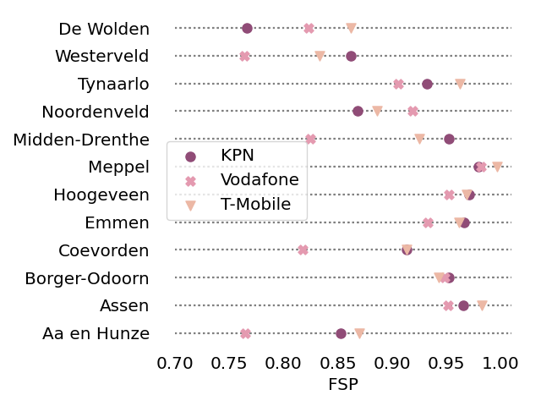
FSP/FDP per municipality (Drenthe)

Slide 2
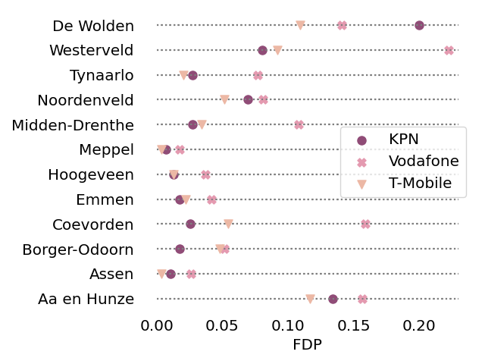
FSP/FDP per municipality (Drenthe)

Slide 3
Failures
Disaster: Circle in the center of province where BSs fail
  Radius: 1km, 5km, 10km, 50km
Rain: (only applicable for > 1GHz)
  2.5 mm/h, 25mm/h, 150mm/h
Random
  BS fails with probability 0.1/0.5/0.9

Slide 4
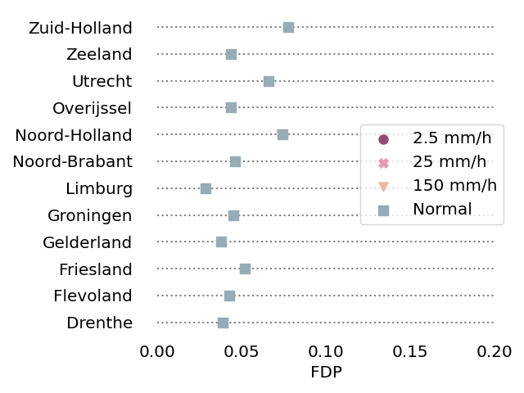
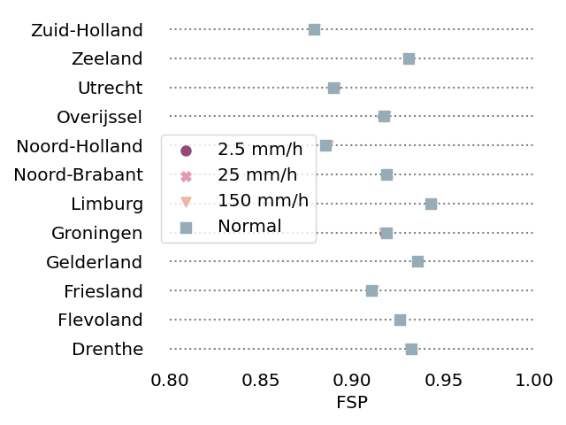
KPN - Rain

Slide 5
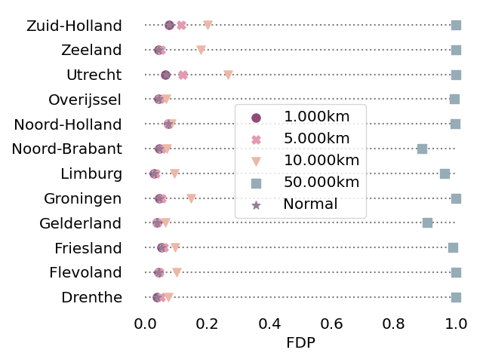
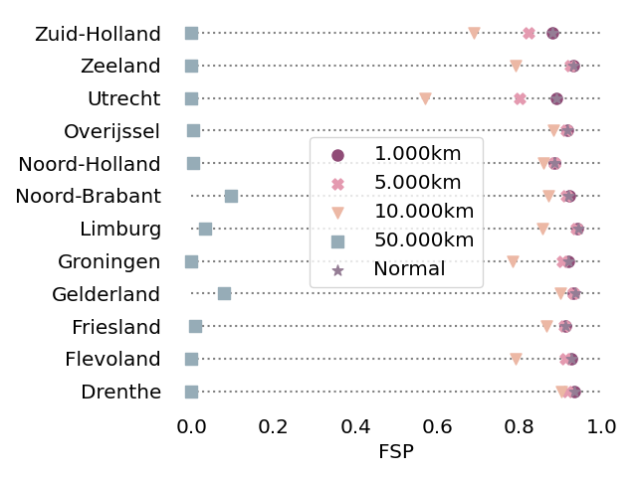
KPN - Disaster

Slide 6
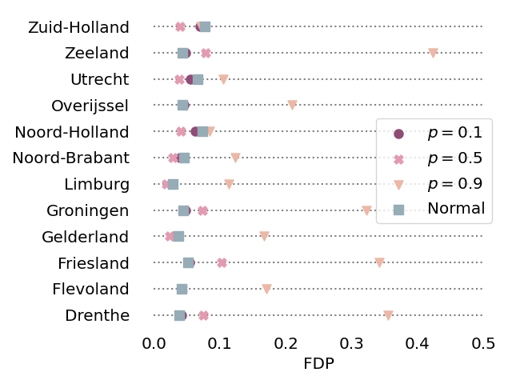
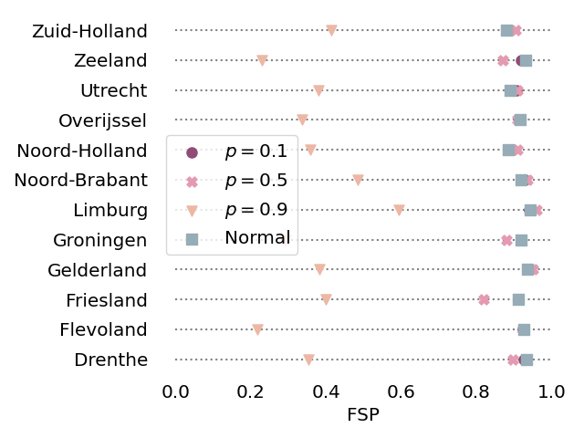
KPN – random failure

Slide 7
Active population – increase? Play with it a bit for a province (increase zip code with highest density?)
How to divide users over BS s? 1/3 1/3 1/3
Zip code – increase in population
Include Umi scenario

